Slide 1
- Douglas Obeng
Analysing crisis events in West Africa for 2021
NB: All data for the analysis were downloaded from https://acleddata.com/

Slide 2
Outline
Initial try
Objective and Introduction
Data
Crisis Event Analysis Using Tableau
Machine translation using huggingface transformer (translation_en_to_fr)
Live view of deployed dashboard
Conclusion

Slide 3
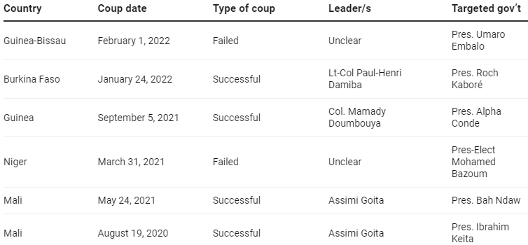
Objectives and Introduction
Introduction
Crisis event management critical to peace/security of states and the world
Understanding the various players and types of events essential for mitigating future events
Terrorism and instability on the rise in West Africa especially in Nigeria and North West Africa
Unsolved minor events lead to major crisis
Objectives
Analyse the crisis event data from ACLED
Translate English notes/comments from English to French (NLP)
Coups in West Africa since 2019
Source: https://theconversation.com/why-west-africa-has-had-so-many-coups-and-how-to-prevent-more-176577

Slide 4
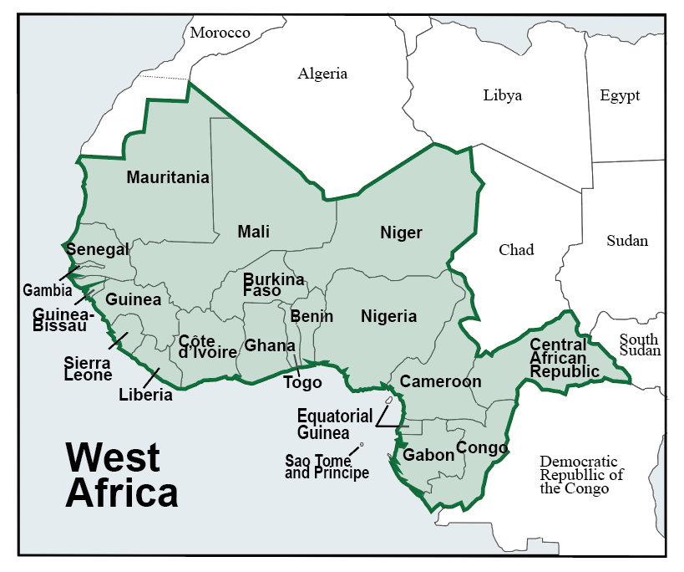
More on West Africa
16 countries
15 ECOWAS
+ Mauritania
380m people (2018 est)
~ 5,112,903 km2
Nigeria - largest population and economy

Slide 5
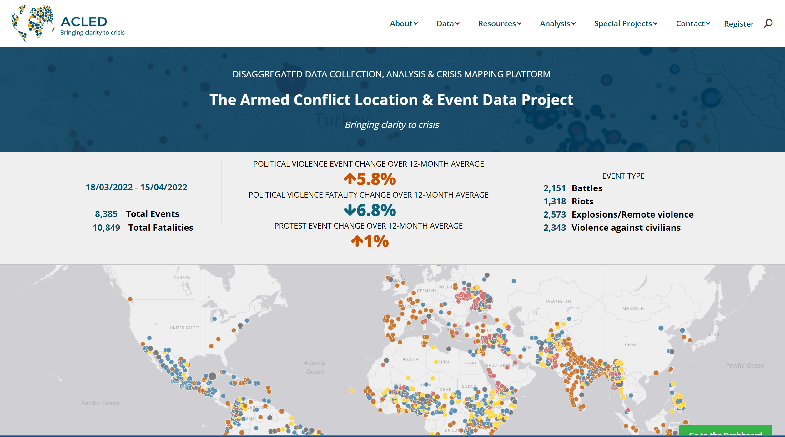
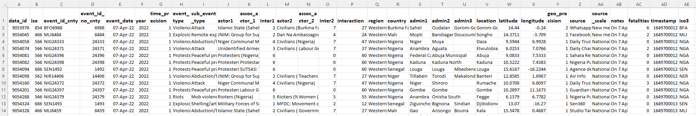
Data
All columns of the ACLED dataset
West Africa
Exported as csv
Data includes:
Location data
Date
Event type
Actors
Notes/Comments
www.acleddata.com
Notes example: On 15 April 2022, suspected JNIM militants attacked a customs checkpoint in Bougoula, in Sikasso Commune (Sikasso, Sikasso). One customs officer and two civilian workers were killed, and a vehicle seized by the militants.

Slide 6
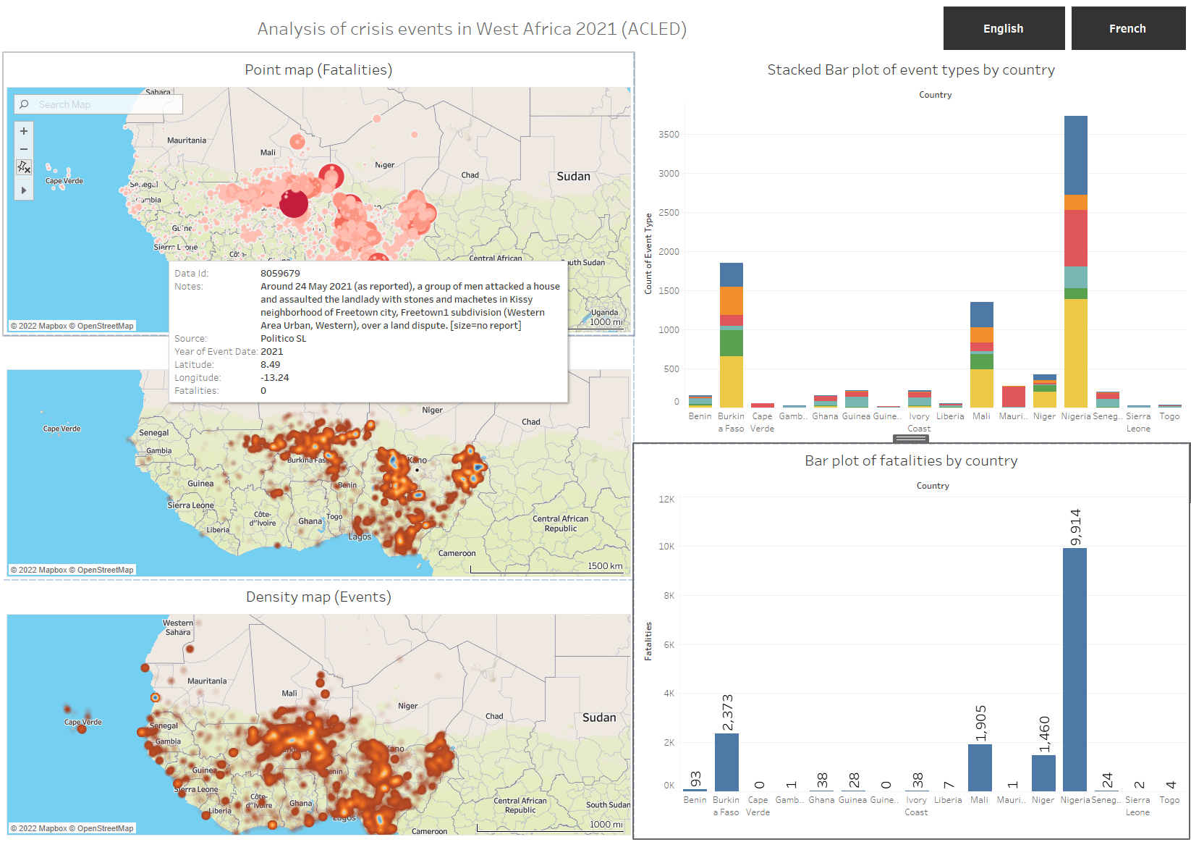
Crisis Event Analysis Using Tableau

Slide 7
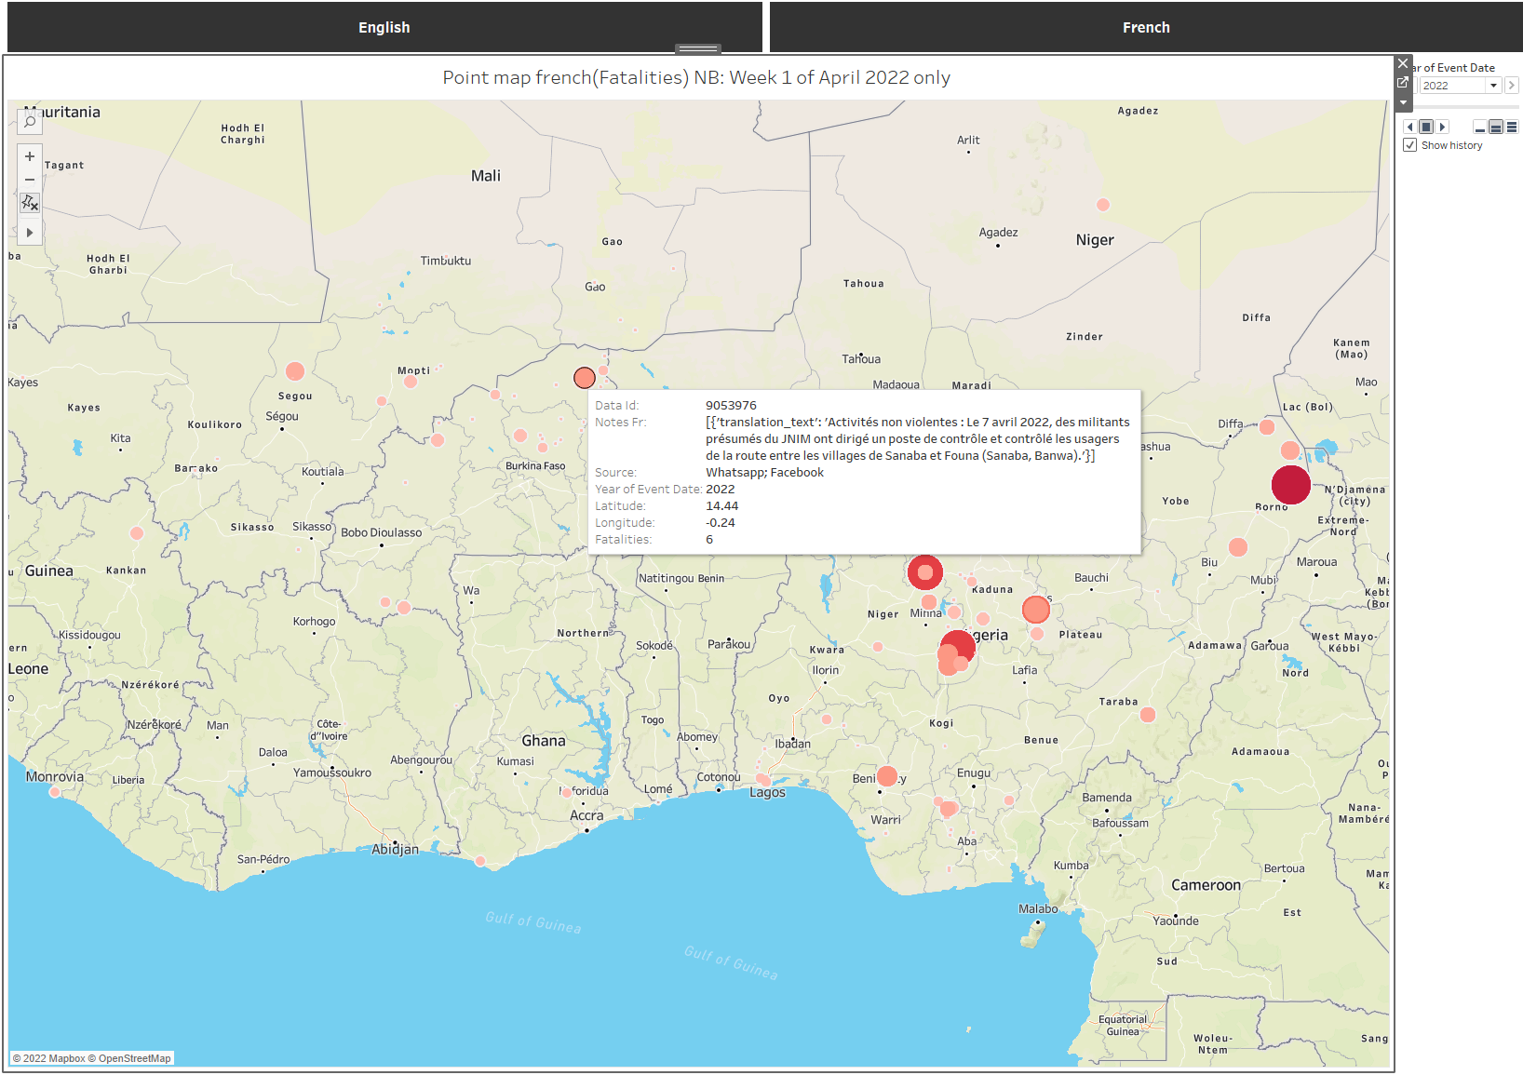
Translating English notes to french
Machine translation
huggingface transformer (translation_en_to_fr)
French labelled dashboard

Slide 8
Live view of deployed dashboard
Live view of dashboard

Slide 9
Conclusion
ACLED data for west Africa analysed using Tableau
Higher event counts and fatalities in North West-Africa and Nigeria
English notes translated to French using huggingface transformer
Results need further cleaning
Some obvious errors
Translation takes a long time

Slide 10
End
Translation notebook: https://github.com/obengdouglas/DSI-2022/blob/main/module3-nlp-twist/Machine_Translation_ACLED1.ipynb
Project data: https://github.com/obengdouglas/DSI-2022/blob/main/module3-nlp-twist/Data

